Slide 1
Parallel Computing
Concurrent Programming CT074-3-2 Version 0120

Slide 2
Parallel Programming Models

Slide 3
Topic & Structure of The Lesson
Overview
Shared Memory Model
Threads Model
Message Passing Model
Data Parallel Model
Other Models

Slide 4
Learning Outcomes
At the end of this topic, You should be able to
Describe Parallel Programming Models

Slide 5
Key Terms You Must Be Able To Use
If you have mastered this topic, you should be able to use the following terms correctly in your assignments and exams:
Shared Memory Model
Threads Model
Message Passing Model
Data Parallel Model
Other Models

Slide 6
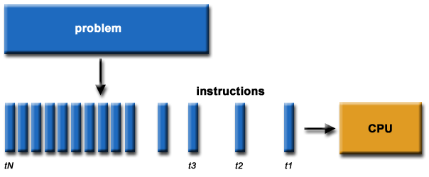
What is Parallel Computing? (1)
Traditionally, software has been written for serial computation:
To be run on a single computer having a single Central Processing Unit (CPU);
A problem is broken into a discrete series of instructions.
Instructions are executed one after another.
Only one instruction may execute at any moment in time.

Slide 7
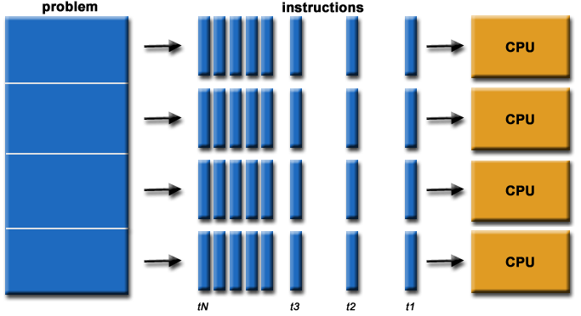
What is Parallel Computing? (2)
In the simplest sense, parallel computing is the simultaneous use of multiple compute resources to solve a computational problem.
To be run using multiple CPUs
A problem is broken into discrete parts that can be solved concurrently
Each part is further broken down to a series of instructions
Instructions from each part execute simultaneously on different CPUs

Slide 8
Parallel Computing: Resources
The compute resources can include:
A single computer with multiple processors;
A single computer with (multiple) processor(s) and some specialized computer resources (GPU, FPGA …)
An arbitrary number of computers connected by a network;
A combination of both.
Notes:
Field-programmable gate array - A field-programmable gate array is an integrated circuit designed to be configured by a customer or a designer after manufacturing – hence the term "field-programmable"

Slide 9
Parallel Computing: The computational problem
The computational problem usually demonstrates characteristics such as the ability to be:
Broken apart into discrete pieces of work that can be solved simultaneously;
Execute multiple program instructions at any moment in time;
Solved in less time with multiple compute resources than with a single compute resource.

Slide 10
Parallel Computing: what for? (1)
Parallel computing is an evolution of serial computing that attempts to emulate what has always been the state of affairs in the natural world: many complex, interrelated events happening at the same time, yet within a sequence.
Some examples:
Planetary and galactic orbits
Weather and ocean patterns
Tectonic plate drift
Rush hour traffic in KL
Automobile assembly line
Daily operations within a business
Building a shopping mall
Ordering a burger at the drive through.

Slide 11
Parallel Computing: what for? (2)
Traditionally, parallel computing has been considered to be "the high end of computing" and has been motivated by numerical simulations of complex systems and "Grand Challenge Problems" such as:
weather and climate
chemical and nuclear reactions
biological, human genome
geological, seismic activity
mechanical devices - from prosthetics to spacecraft
electronic circuits
manufacturing processes

Slide 12
Parallel Computing: what for? (3)
Today, commercial applications are providing an equal or greater driving force in the development of faster computers. These applications require the processing of large amounts of data in sophisticated ways. Example applications include:
parallel databases, data mining
oil exploration
web search engines, web based business services
computer-aided diagnosis in medicine
management of national and multi-national corporations
advanced graphics and virtual reality, particularly in the entertainment industry
networked video and multi-media technologies
collaborative work environments
Ultimately, parallel computing is an attempt to maximize the infinite but seemingly scarce commodity called time.

Slide 13
Why Parallel Computing? (1)
This is a legitimate question! Parallel computing is complex on any aspect!
The primary reasons for using parallel computing:
Save time - wall clock time
Solve larger problems
Provide concurrency (do multiple things at the same time)
Notes:
Wall clock time is the actual amount of time taken to perform a job.
This is equivalent to timing your job with a stopwatch and the measured time to complete your task can be affected by anything else that the system happens to be doing at the time.
User time measures the amount of time the CPU spent running your code

Slide 14
Why Parallel Computing? (2)
Other reasons might include:
Taking advantage of non-local resources - using available compute resources on a wide area network, or even the Internet when local compute resources are scarce.
Cost savings - using multiple "cheap" computing resources instead of paying for time on a supercomputer.
Overcoming memory constraints - single computers have very finite memory resources. For large problems, using the memories of multiple computers may overcome this obstacle.

Slide 15
Limitations of Serial Computing
Limits to serial computing - both physical and practical reasons pose significant constraints to simply building ever faster serial computers.
Transmission speeds - the speed of a serial computer is directly dependent upon how fast data can move through hardware. Absolute limits are the speed of light (30 cm/nanosecond) and the transmission limit of copper wire (9 cm/nanosecond). Increasing speeds necessitate increasing proximity of processing elements.
Limits to miniaturization - processor technology is allowing an increasing number of transistors to be placed on a chip. However, even with molecular or atomic-level components, a limit will be reached on how small components can be.
Economic limitations - it is increasingly expensive to make a single processor faster. Using a larger number of moderately fast commodity processors to achieve the same (or better) performance is less expensive.

Slide 16
The future
during the past 10 years, the trends indicated by ever faster networks, distributed systems, and multi-processor computer architectures (even at the desktop level) clearly show that parallelism is the future of computing.
It will be multi-forms, mixing general purpose solutions (your PC…) and very speciliazed solutions as IBM Cells, ClearSpeed, GPGPU from NVidia …

Slide 17
Overview
There are several parallel programming models in common use:
Shared Memory
Threads
Message Passing
Data Parallel
Hybrid
Parallel programming models exist as an abstraction above hardware and memory architectures.

Slide 18
Overview
Although it might not seem apparent, these models are NOT specific to a particular type of machine or memory architecture. In fact, any of these models can (theoretically) be implemented on any underlying hardware.
Shared memory model on a distributed memory machine: Kendall Square Research (KSR) ALLCACHE approach.
Machine memory was physically distributed, but appeared to the user as a single shared memory (global address space). Generically, this approach is referred to as "virtual shared memory".
Note: although KSR is no longer in business, there is no reason to suggest that a similar implementation will not be made available by another vendor in the future.
Message passing model on a shared memory machine: MPI on SGI Origin.
The SGI Origin employed the CC-NUMA type of shared memory architecture, where every task has direct access to global memory. However, the ability to send and receive messages with MPI, as is commonly done over a network of distributed memory machines, is not only implemented but is very commonly used.
Notes:
Kendall Square Research was a supercomputer company headquartered originally in Kendall Square in Cambridge, Massachusetts in 1986, near Massachusetts Institute of Technology. It was co-founded by Steven Frank and Henry Burkhardt III, who had formerly helped found Data General and Encore Computer and was one of the original team that designed the PDP-8. KSR produced two models of supercomputer, the KSR1 and KSR2.
NUMA Non-uniform memory access is a computer memory design used in multiprocessing, where the memory access time depends on the memory location relative to the processor. Under NUMA, a processor can access its own local memory faster than non-local memory.

Slide 19
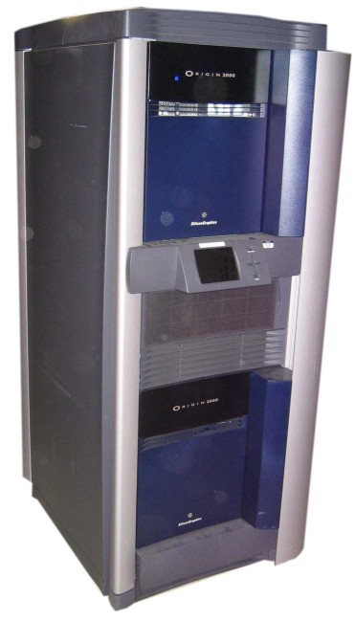
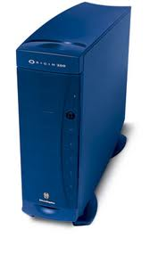
The SGI Origin is a family of mid-range and high-end server computers developed and manufactured by Silicon Graphics (SGI).
Notes:
Message Passing Interface is a standardized and portable message-passing standard designed by a group of researchers from academia and industry to function on a wide variety of parallel computing architectures.

Slide 20
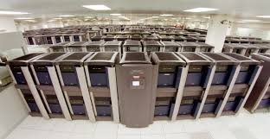
SGI Origin 2000

Slide 21
Overview
Which model to use is often a combination of what is available and personal choice. There is no "best" model, although there certainly are better implementations of some models over others.
The following sections describe each of the models mentioned above, and also discuss some of their actual implementations.

Slide 22
Shared Memory Model
In the shared-memory programming model, tasks share a common address space, which they read and write asynchronously.
Various mechanisms such as locks / semaphores may be used to control access to the shared memory.
An advantage of this model from the programmer's point of view is that the notion of data "ownership" is lacking, so there is no need to specify explicitly the communication of data between tasks. Program development can often be simplified.
An important disadvantage in terms of performance is that it becomes more difficult to understand and manage data locality.

Slide 23
Shared Memory Model: Implementations
On shared memory platforms, the native compilers translate user program variables into actual memory addresses, which are global.
No common distributed memory platform implementations currently exist. However, as mentioned previously in the Overview section, the KSR ALLCACHE approach provided a shared memory view of data even though the physical memory of the machine was distributed.

Slide 24
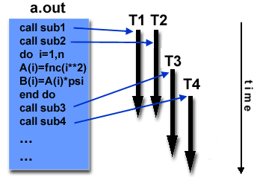
Threads Model
In the threads model of parallel programming, a single process can have multiple, concurrent execution paths.
Perhaps the most simple analogy that can be used to describe threads is the concept of a single program that includes a number of subroutines:

Slide 25
The main program a.out is scheduled to run by the native operating system. a.out loads and acquires all of the necessary system and user resources to run.
a.out performs some serial work, and then creates a number of tasks (threads) that can be scheduled and run by the operating system concurrently.
Each thread has local data, but also, shares the entire resources of a.out. This saves the overhead associated with replicating a program's resources for each thread. Each thread also benefits from a global memory view because it shares the memory space of a.out.
A thread's work may best be described as a subroutine within the main program. Any thread can execute any subroutine at the same time as other threads.
Threads communicate with each other through global memory (updating address locations). This requires synchronization constructs to insure that more than one thread is not updating the same global address at any time.
Threads can come and go, but a.out remains present to provide the necessary shared resources until the application has completed.
Threads are commonly associated with
shared memory architectures and
operating systems.

Slide 26
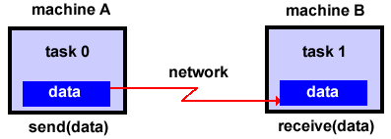
Threads Model Implementations
From a programming perspective, threads implementations commonly comprise:
A library of subroutines that are called from within parallel source code
A set of compiler directives imbedded in either serial or parallel source code
In both cases, the programmer is responsible for determining all parallelism.
Threaded implementations are not new in computing. Historically, hardware vendors have implemented their own proprietary versions of threads. These implementations differed substantially from each other making it difficult for programmers to develop portable threaded applications.
Unrelated standardization efforts have resulted in two very different implementations of threads: POSIX Threads and OpenMP.
POSIX Threads
Library based; requires parallel coding
Specified by the IEEE POSIX 1003.1c standard (1995).
C Language only
Commonly referred to as Pthreads.
Most hardware vendors now offer Pthreads in addition to their proprietary threads implementations.
Very explicit parallelism; requires significant programmer attention to detail.
Notes:
POSIX Threads, usually referred to as pthreads, is an execution model that exists independently from a language, as well as a parallel execution model. It allows a program to control multiple different flows of work that overlap in time. Each flow of work is referred to as a thread, and creation and control over these flows is achieved by making calls to the POSIX Threads API. POSIX Threads is an API defined by the standard POSIX.1c, Threads extensions (IEEE Std 1003.1c-1995).

Slide 27
Threads Model: OpenMP
OpenMP
Compiler directive based; can use serial code
Jointly defined and endorsed by a group of major computer hardware and software vendors. The OpenMP Fortran API was released October 28, 1997. The C/C++ API was released in late 1998.
Portable / multi-platform, including Unix and Windows NT platforms
Available in C/C++ and Fortran implementations
Can be very easy and simple to use - provides for "incremental parallelism"
Microsoft has its own implementation for threads, which is not related to the UNIX POSIX standard or OpenMP.
Notes:
The application programming interface (API) OpenMP (Open Multi-Processing) supports multi-platform shared-memory multiprocessing programming in C, C++, and Fortran,^{[3]} on many platforms, instruction-set architectures and operating systems, including Solaris, AIX, HP-UX, Linux, macOS, and Windows. It consists of a set of compiler directives, library routines, and environment variables that influence run-time behavior.

Slide 28
Message Passing Model
The message passing model demonstrates the following characteristics:
A set of tasks that use their own local memory during computation. Multiple tasks can reside on the same physical machine as well across an arbitrary number of machines.
Tasks exchange data through communications by sending and receiving messages.
Data transfer usually requires cooperative operations to be performed by each process. For example, a send operation must have a matching receive operation.

Slide 29
Message Passing Model Implementations: MPI
From a programming perspective, message passing implementations commonly comprise a library of subroutines that are imbedded in source code. The programmer is responsible for determining all parallelism.
Historically, a variety of message passing libraries have been available since the 1980s. These implementations differed substantially from each other making it difficult for programmers to develop portable applications.
In 1992, the MPI Forum was formed with the primary goal of establishing a standard interface for message passing implementations. https://www.mpi-forum.org/
Part 1 of the Message Passing Interface (MPI) was released in 1994. Part 2 (MPI-2) was released in 1996. Both MPI specifications are available on the web at https://www.mcs.anl.gov/research/projects/mpi/.

Slide 30
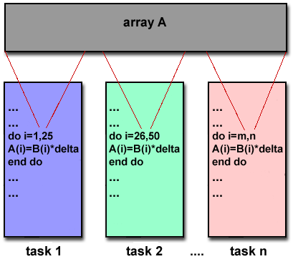
Message Passing Model Implementations: MPI
MPI is now the "de facto" industry standard for message passing, replacing virtually all other message passing implementations used for production work. Most, if not all of the popular parallel computing platforms offer at least one implementation of MPI. A few offer a full implementation of MPI-2.
For shared memory architectures, MPI implementations usually don't use a network for task communications. Instead, they use shared memory (memory copies) for performance reasons.

Slide 31
Data Parallel Model
The data parallel model demonstrates the following characteristics:
Tasks are assigned to processes and each task performs similar types of operations on different data.
Most of the parallel work focuses on performing operations on a data set. The data set is typically organized into a common structure, such as an array or cube.
A set of tasks work collectively on the same data structure, however, each task works on a different partition of the same data structure.
Tasks perform the same operation on their partition of work, for example, "add 4 to every array element".
On shared memory architectures, all tasks may have access to the data structure through global memory. On distributed memory architectures the data structure is split up and resides as "chunks" in the local memory of each task.

Slide 32
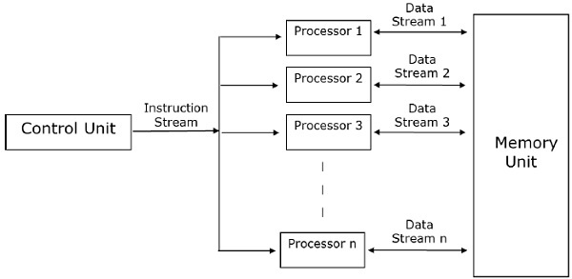
Data Parallel Model

Slide 33
Data Parallel Model Implementations
Programming with the data parallel model is usually accomplished by writing a program with data parallel constructs. The constructs can be calls to a data parallel subroutine library or, compiler directives recognized by a data parallel compiler.
Fortran 90 and 95 (F90, F95): ISO/ANSI standard extensions to Fortran 77.
Contains everything that is in Fortran 77
New source code format; additions to character set
Additions to program structure and commands
Variable additions - methods and arguments
Pointers and dynamic memory allocation added
Array processing (arrays treated as objects) added
Recursive and new intrinsic functions added
Many other new features
Implementations are available for most common parallel platforms.

Slide 34
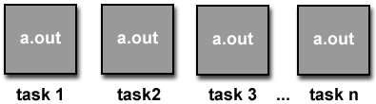
Data Parallel Model Implementations
High Performance Fortran (HPF): Extensions to Fortran 90 to support data parallel programming.
Contains everything in Fortran 90
Directives to tell compiler how to distribute data added
Assertions that can improve optimization of generated code added
Data parallel constructs added (now part of Fortran 95)
Implementations are available for most common parallel platforms.
Compiler Directives: Allow the programmer to specify the distribution and alignment of data. Fortran implementations are available for most common parallel platforms.
Distributed memory implementations of this model usually have the compiler convert the program into standard code with calls to a message passing library (MPI usually) to distribute the data to all the processes. All message passing is done invisibly to the programmer.

Slide 35
Other Models
Other parallel programming models besides those previously mentioned certainly exist, and will continue to evolve along with the ever changing world of computer hardware and software.
Only three of the more common ones are mentioned here.
Hybrid
Single Program Multiple Data
Multiple Program Multiple Data

Slide 36
Hybrid
In this model, any two or more parallel programming models are combined.
Currently, a common example of a hybrid model is the combination of the message passing model (MPI) with either the threads model (POSIX threads) or the shared memory model (OpenMP). This hybrid model lends itself well to the increasingly common hardware environment of networked SMP machines.
Another common example of a hybrid model is combining data parallel with message passing. As mentioned in the data parallel model section previously, data parallel implementations (F90, HPF) on distributed memory architectures actually use message passing to transmit data between tasks, transparently to the programmer.

Slide 37
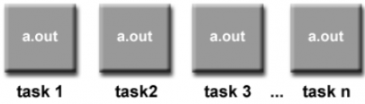
Single Program Multiple Data (SPMD)
Single Program Multiple Data (SPMD):
SPMD is actually a "high level" programming model that can be built upon any combination of the previously mentioned parallel programming models.
A single program is executed by all tasks simultaneously.
At any moment in time, tasks can be executing the same or different instructions within the same program.
SPMD programs usually have the necessary logic programmed into them to allow different tasks to branch or conditionally execute only those parts of the program they are designed to execute. That is, tasks do not necessarily have to execute the entire program - perhaps only a portion of it.
All tasks may use different data

Slide 38
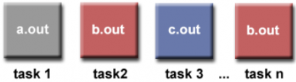
Multiple Program Multiple Data (MPMD)
Multiple Program Multiple Data (MPMD):
Like SPMD, MPMD is actually a "high level" programming model that can be built upon any combination of the previously mentioned parallel programming models.
MPMD applications typically have multiple executable object files (programs). While the application is being run in parallel, each task can be executing the same or different program as other tasks.
All tasks may use different data

Slide 39
Summary
parallelism is ubiquitous in computing; it is present in hardware devices, in computational problems, in algorithms, and in software on all levels.
Consequently, many opportunities for improving the efficiency of parallel programs are ever present.

Slide 40
Summary
theoreticians and scientists can search for and design new, improved parallel algorithms
programmers can develop better tools for compiling and debugging parallel programs
cooperation with engineers can lead to faster and more efficient parallel programs and hardware devices.
Notes:
In computing, floating point operations per second (FLOPS, flops or flop/s) is a measure of computer performance, useful in fields of scientific computations that require floating-point calculations. For such cases it is a more accurate measure than measuring instructions per second.

Slide 41
Summary
Current high-performance computers, containing millions of cores, can execute more than 2000 floating point operations per second (200 petaFLOPS).
No significant shift in computing performance until a new production technology for computing devices is invented.
Until then, the maximal exploitation of parallelism will be our challenge.

Slide 42
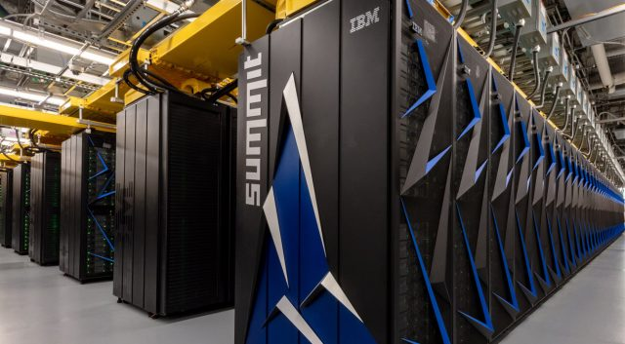
IBM Summit

Slide 43
2.4 exaflop computer fighting coronavirus
https://www.electronicsweekly.com/news/business/2-4-exaflop-computer-fighting-coronavirus-2020-05/
By linking almost a million PCs
Owners of PCs download the software from Folding@Home which then uses spare time on the PCs to perform the calculations.

Slide 44
End of module
Q&A

Slide 45
Assignment Submission
Part 2 – System, Presentation and Report
Submit to Moodle
Due: Friday 12th November 2021
Before 11:59 p.m.

Slide 46
Assignment Submission
Part 2 Report
Basic requirements met:
Planes must fly
Code snippet
Planes must acquire runway
Code snippet
…..
Additional requirements met:
Plane out of fuel
Code snippet
Number of planes leaving
Code snippet
…..
Requirements which were NOT met:

Slide 47
Assignment Submission
Assignment presentation –
5 minutes
Talk about code and console output
What requirements are met
What requirements are not met
No silent moments!

Slide 48
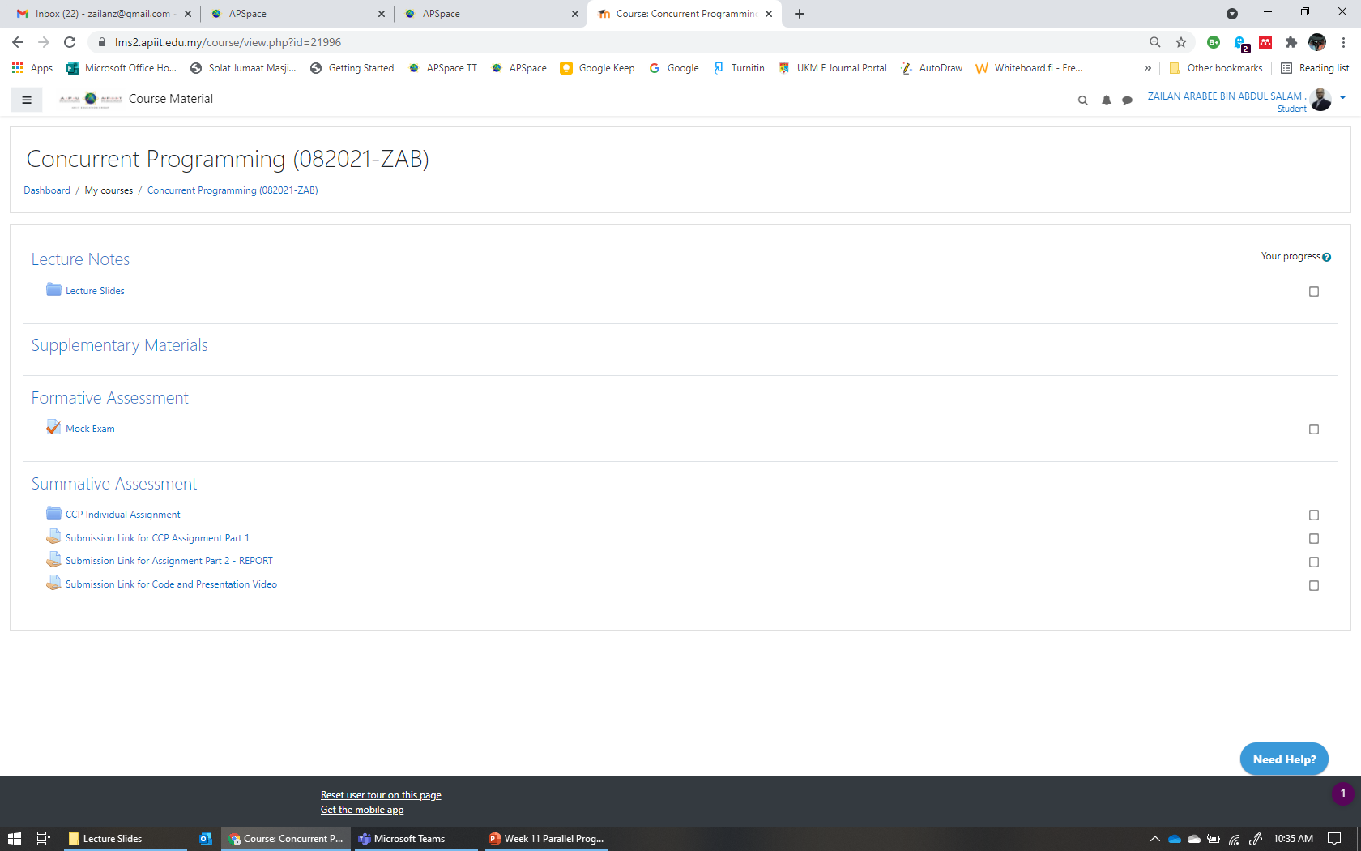
Part 2 Submission
Report
Code & Video

